Slide 1
Team 2 Project FAANG Stock Price Analysis
Team Guide:
Cyril Michino
Team Members:
Jane Thiong’o
Ivy Andia Wakhu
Anne Siloma

Slide 2

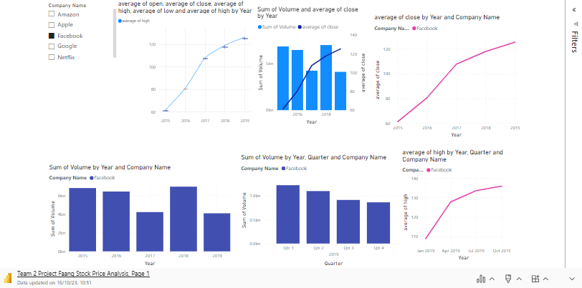
Microsoft Power BI

Slide 3

Relaunch the add-in
Microsoft Power BI
After you install the add-in, you can launch it by choosing the add-in button on the Insert tab
On the Insert tab
Insert
My Add-ins
Need more help?
Return to your internet browser or copy this link into your browser:
https://pages.store.office.com/addinsinstallpage.aspx?rs=en-GB&assetid=WA200003233&isWac=True&ui=en-US&ad=GB

Slide 4
Trend of volume of shares traded and price of stock.
The largest volume of stock was traded in 2015.
The volume decreased as prices increased, but volume increased when there was a spike in stock prices in 2018.
As stock prices went on increasing steadily, volume of shares traded started decreasing again.
Apple had the largest volume of shares traded
Apple has the cheapest stock prices.
Amazon and google had the least volume of shares traded.
Amazon and google had the highest stock prices.

Slide 5
As stock prices increase, volume of stock shares traded reduces except when there is a sharp increase in prices.
Why?
Investors might perceive lower-prices stocks as having more room for growth, leading to them buying more shares of that stock.
Lower-priced stocks are more accessible to individual investors with limited capital.
Higher-priced stocks tend to have lower volatility since a small price change represents a smaller percentage change.
Sharp increase in prices leads to increased trading volumes as investors react to news of the sharp increase. This is caused by fear of missing out or herding behavior.

Slide 6
Trend of volume as you move from the first quarter to the last quarter.
Amazon, Apple and Facebook trading volumes decreased from the first quarter to the last quarter.
Why?
In the last quarter, there are holiday seasons as market participants take vacations or reduce trading activities.
As the year progresses, investors might become more cautious about uncertainties, economic slowdowns(wait and see approach), and geopolitical tensions.
Some traders/investors might reduce trading activity due to reduced market liquidity.

Slide 7
Trend of volume as you move from the first quarter to the last quarter.
Participants might also reduce trading activities in the last quarter if they have met their financial goals and rebalanced their portfolios.
Large trading volumes in the first quarter can be attributed to year end reporting and positive market sentiment(January effect).

Slide 8
Trends in stock prices from the first quarter to the fourth quarter of a year.
There’s no uniform noticeable trend in the FAANG stock prices.
Stock market is influenced by a complex interplay of factors:-
Unpredictable events(pandemics, natural disasters, terrorist attacks)
Global markets(events and news from international markets can impact prices at any time).
Varied influences(economic indicators, interest rate changes, investor sentiment, corporate earnings reports).

Slide 9
Annual Returns was unexpectedly high for Netflix on 2015.
It had a value of 34.9, which is outside the expected range of 26.42-33.42.
This could be attributed to:-
Success with its original content or expanded its content library, attracting more subscribers and investors.
Expansion to more international markets, leading to increased subscriber growth and positive investor sentiment.

Slide 10
Annual Returns was unexpectedly high for Apple on 2019.
It had a value of 47.12, which is outside the expected range of 29.91-37.21.
Why?
Apple may have had successful iPhone releases or strong sales in other product categories.
Apple's services segment, including the App Store, Apple Music, and other services, may have shown robust growth.
Apple's financial strategies, such as stock buybacks or dividends, might have pleased investors.

Slide 11
Annual Returns was unexpectedly high for Google on 2019.
It had a value of 23.11, which is outside the expected range of 12.41-13.63.
Why?
Google, being a major player in online advertising, might have experienced strong revenue growth in this segment.
Google Cloud or other services might have seen increased adoption, contributing to positive investor sentiment.

Slide 12
Annual Returns for Apple trended up between 2015 and 2019.
Why?
This could be attributed to successful product releases during this period could have contributed to increased sales and revenue, positively impacting stock prices and, consequently, annual returns.
A diverse and successful product lineup can contribute to overall revenue growth.
Apple's commitment to innovation and its strong brand loyalty among consumers contribute to sustained customer interest and demand for its products.
Favorable economic conditions and consumer confidence during this period could have contributed to increased consumer spending on Apple products.

